Slide 1

TIME

Slide 2


Slide 3
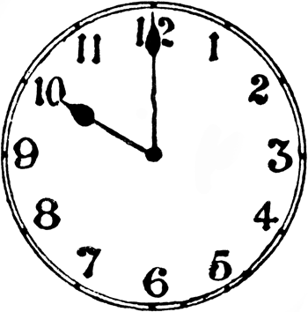
O CLOCK
O clock is a type of time that the big hand is always pointing to the twelve and the little hand is pointing to what O clock it is FOR EXAMPLE THIS CLOCK IS O CLOCK
Did you know
That o clock
means on
the clock

Slide 4
PAST AND TO
I’ve heard you’ve been working on time so I’m teaching you a bit more about time
There are two things in time that shows you when something is going to a certain time or if something is past a certain time
These are called past and to. Past is on the right of the clock and that leaves to on the left

Slide 5
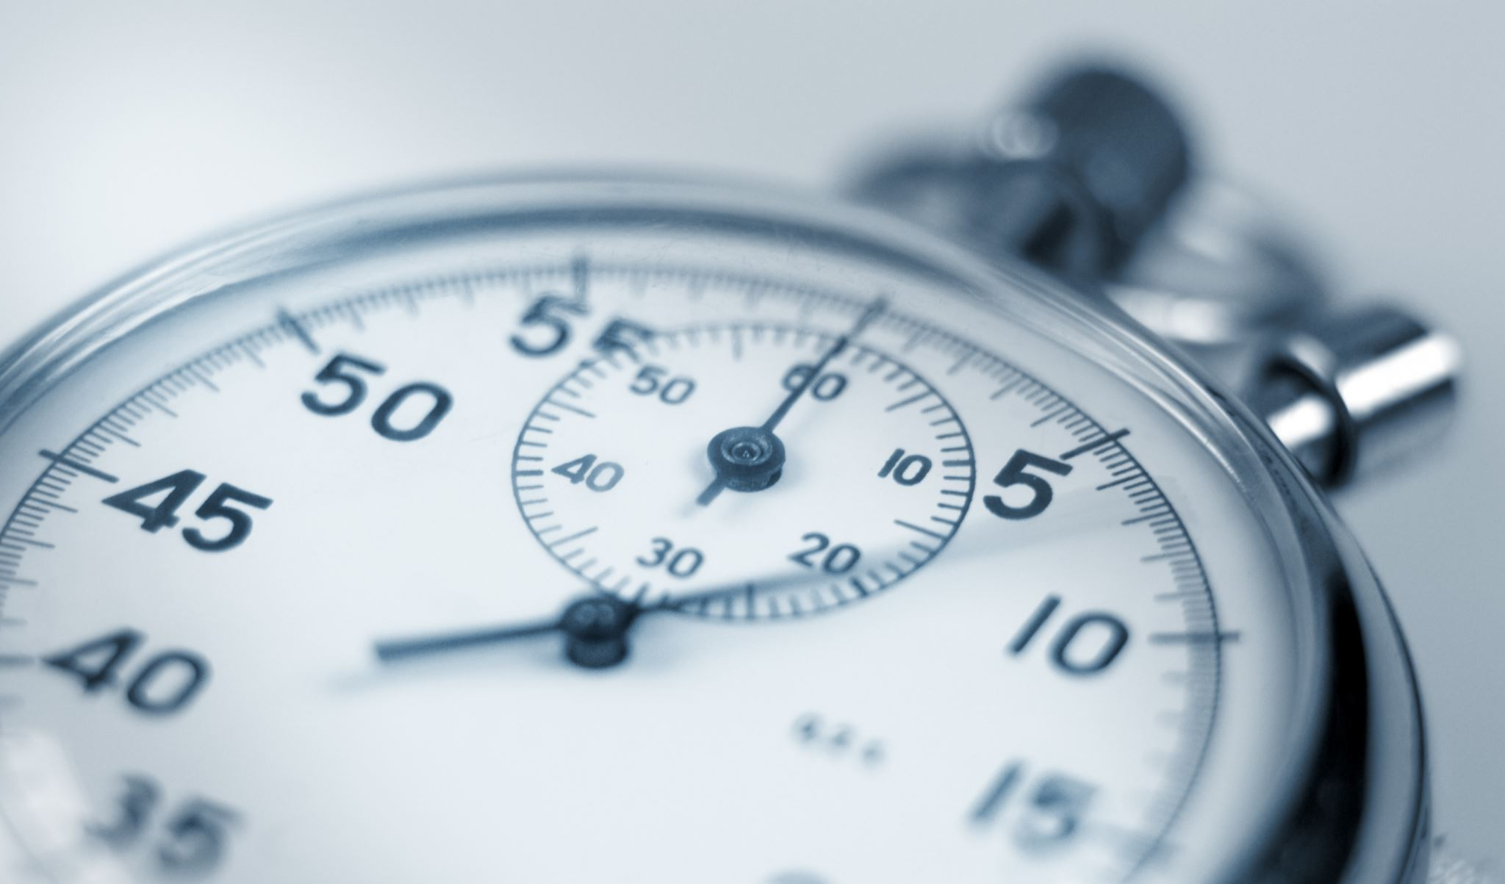
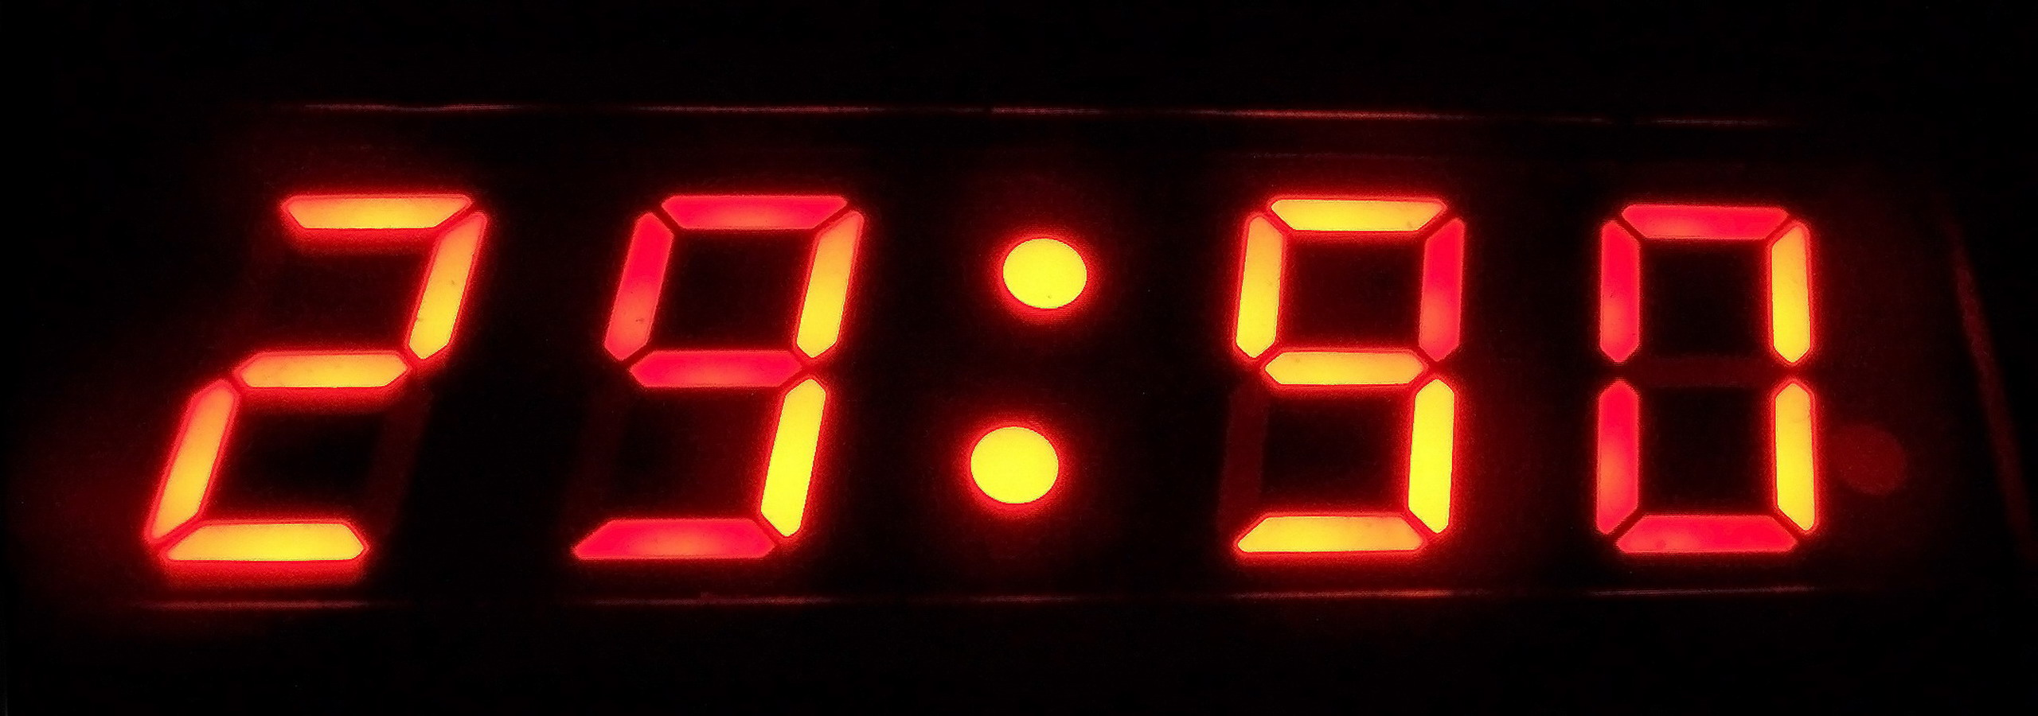
DIGITAL and ANALOG
A
There are two types of time, digital and analog, analog is a clock like a clock on the wall and an analog has hands on it, digital is a clock that has no hands and it has a number at the start based by how many hours past twelve it is.

Slide 6
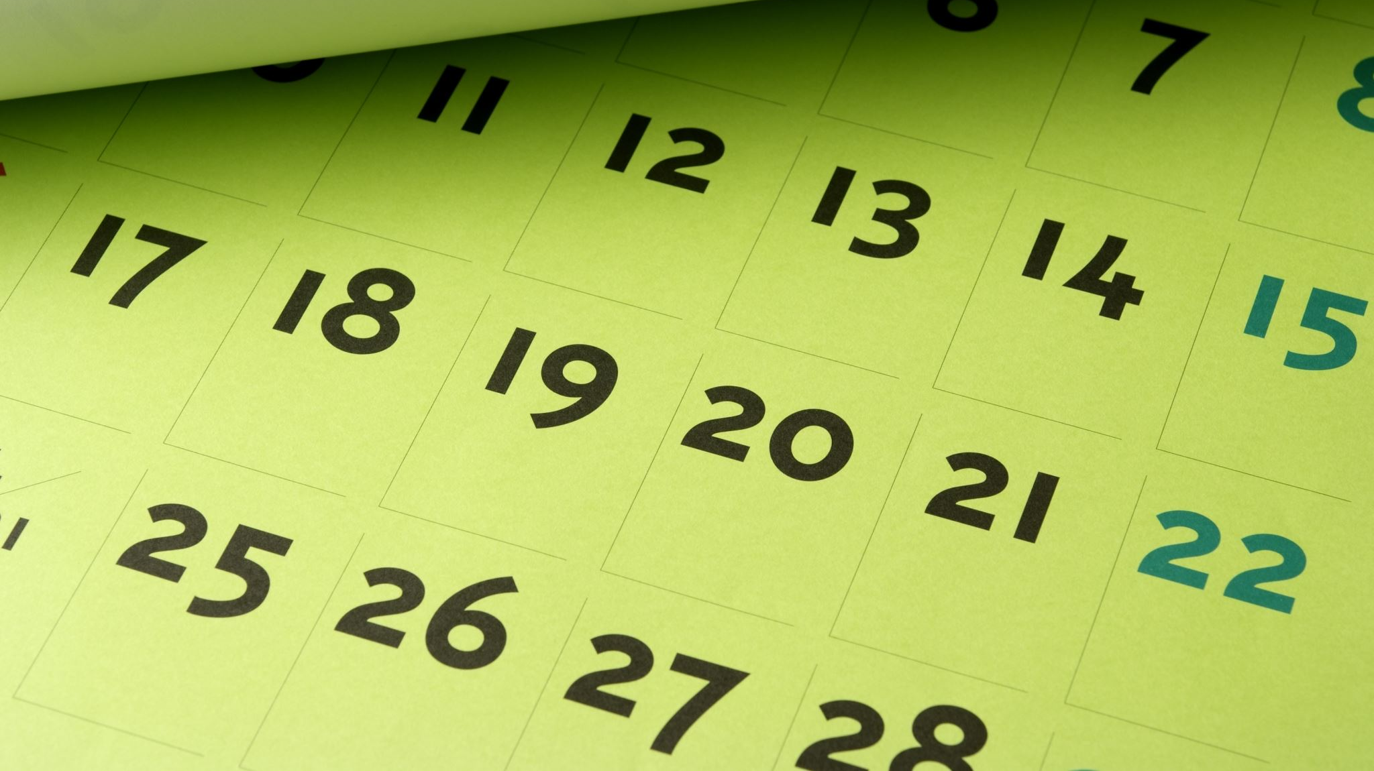
QUARTER TO and QUARTER PAST
quarter past and quarter to means 15 past or to.

